Slide 1
Monitoring
Monitoring Techniques
Notes:
Notes to the Facilitator:
Welcome the participants and give them an overview of the module. Tell them that they will learn about the ‘Infrastructure Monitoring’ in this module.
Notes to the Participants:
You will learn about the ‘Log Monitoring and Analysis’ in this module.

Slide 2
Module Objective
At the end of this module, you will be able to:
Explain visualisation of monitoring data
Describe how to set up alerts and the process of alert triage
Dashboarding with hygieia
Scope of AI in Monitoring - AIOPS
Identify the available tools of monitoring
Notes:
Notes to the Facilitator:
Explain the module objectives to the participants.
Notes to the Participants:
You will be informed about the module objectives.
At the end of this module, you will be able to:
Visualisation of monitoring data
Setting up alerts
Process of Alert triage
Dashboarding with hygieia
Scope of AI in Monitoring - AIOPS
Identify the available tools of monitoring

Slide 3
Module Topics
This module covers the following topics:
Visualization - Dashboards
Alerts
Alert triage process
DevOps dashboard with Hygieia
AI in monitoring - AIOps
Tools overview
Notes:
Notes to the Facilitator:
Inform the participants about the topics that they will be learning in this module.
Notes to the Participants:
You will learn about the following topics in this module:
Visualization - Dashboards
Alerts
Alert triage process
DevOps dashboard with Hygieia
AI in monitoring - AIOps
Tools overview

Slide 4
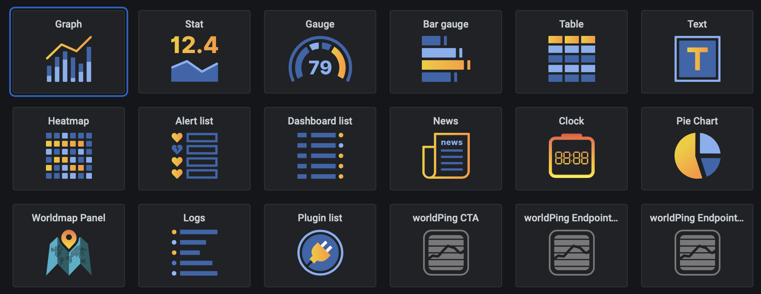
1.1 Visualization - Dashboards
Data visualisation can be done in various interesting formats.
Notes:
Notes to the Facilitator:
Explain the Visualization - Dashboards to the participants.
Notes to the Participants:
All types of monitoring, which we have covered in previous modules, have one identical feature that is visualisation. Humans by default are visual beings they process information better when it is visual. Hence, leveraging this is obvious. Therefore, most of the monitoring tools provide amazing visual dashboards having all necessary information described in an organised format like:
Graphs
Pie charts
Stats
Gauge
Table
Bar gauge
Text
Heatmap, etc

Slide 5
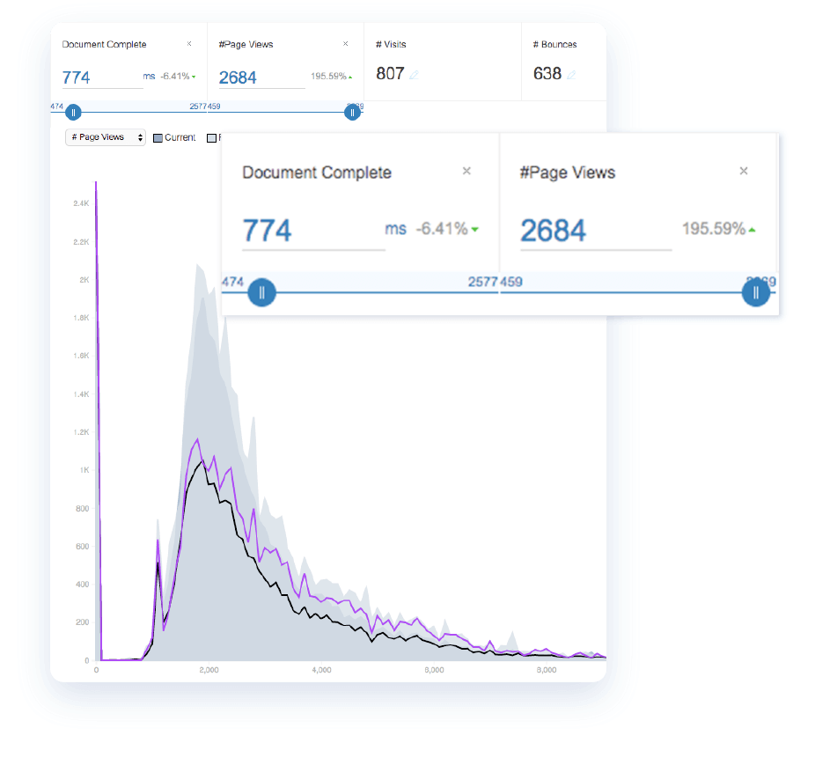
1.2.1 Visualisation in End User Monitoring
The following graph displays the real user monitoring in catch point.
The graph shows the certain points, like:
Page view
Traffic count
Document loaded etc.
Source: https://assets-global.website-files.com/5babb9f91ab233724e53ce0b/5f9abac870a22c5f07ba047b_Optimize%20performance.png
Notes:
Notes to the Facilitator:
Explain the Visualization - in End User Monitoring.
Notes to the Participants:
In this graph, real user monitoring is being visualised, in this monitoring the experience of actual users interaction with your application is showed. Real user monitoring provides you with the most accurate information regarding the end user’s experience. This is also known as passive monitoring.
Here, in this graph, certain points are being shown, like:
Page view
Traffic count
Document loaded etc.

Slide 6
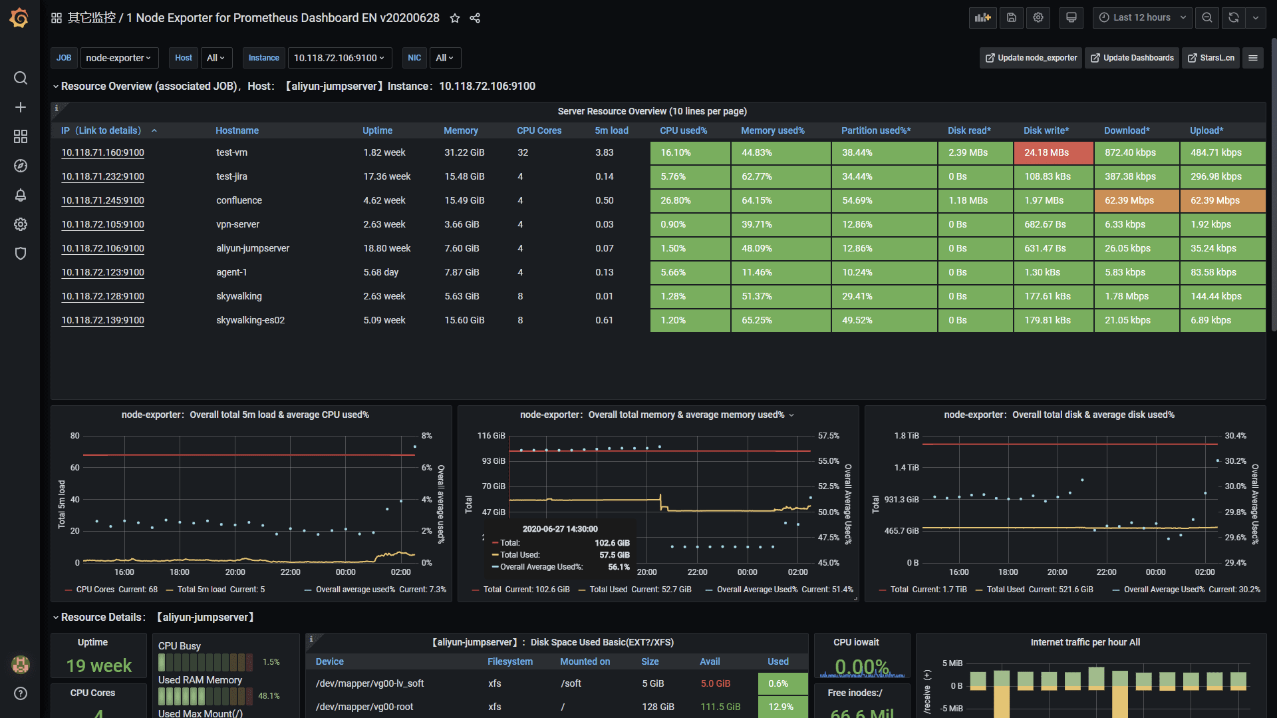
1.2.2 Visualisation in Infrastructure Monitoring
The following graph displays the Prometheus monitoring visualised in Grafana dashboard.
The metrics, which are being visualised are:
Uptime
Memory
CPU cores
CPU utilisation
Logical volume mounting
Storage stats
Network I/O etc.
Source: https://raw.githubusercontent.com/starsliao/Prometheus/master/node_exporter/ensa.png
Notes:
Notes to the Facilitator:
Explain the Visualization in Infrastructure Monitoring to the participants.
Notes to the Participants:
Infrastructure monitoring is the monitoring of servers, network and storage devices, which makes an IT infrastructure.
In this graph, the metrics of a Linux server have been visualised, which are collected by node exporter, which are picked by prometheus via telemetry and then visualised on Grafana dashboard.
The metrics, which are being visualised are:
Uptime
Memory
CPU cores
CPU utilisation
Logical volume mounting
Storage stats
Network I/O etc.

Slide 7
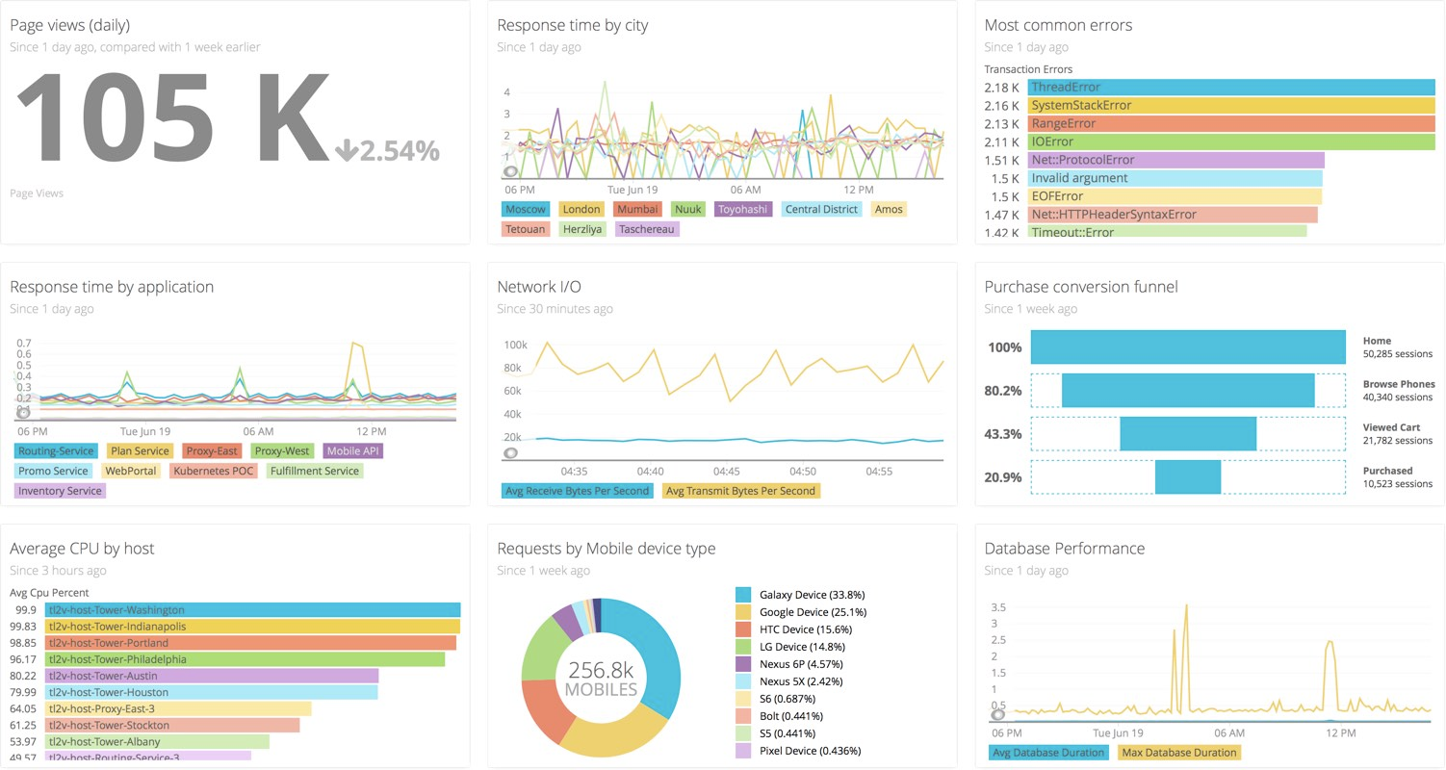
1.2.3 Visualisation in Application Monitoring
The graph displays the Application Monitoring data visualised on New Relic.
The metrics, which are being visualised are:
Active users
Response time by application
Avg CPU utilisation
Request by device
Common errors
Database performance etc.
Notes:
Notes to the Facilitator:
Explain the Visualization in Application Monitoring to the participants.
Notes to the Participants:
An Application monitoring is a method, which is needed to ensure that the website or application that is created with immense hardwork and dedication, is delivering the business value as it is supposed to be. APM is the IT discipline that focuses on application monitoring and management.
The metrics, which are being visualised are:
Active users
Response time by application
Avg CPU utilisation
Request by device
Common errors
Database performance etc.

Slide 8
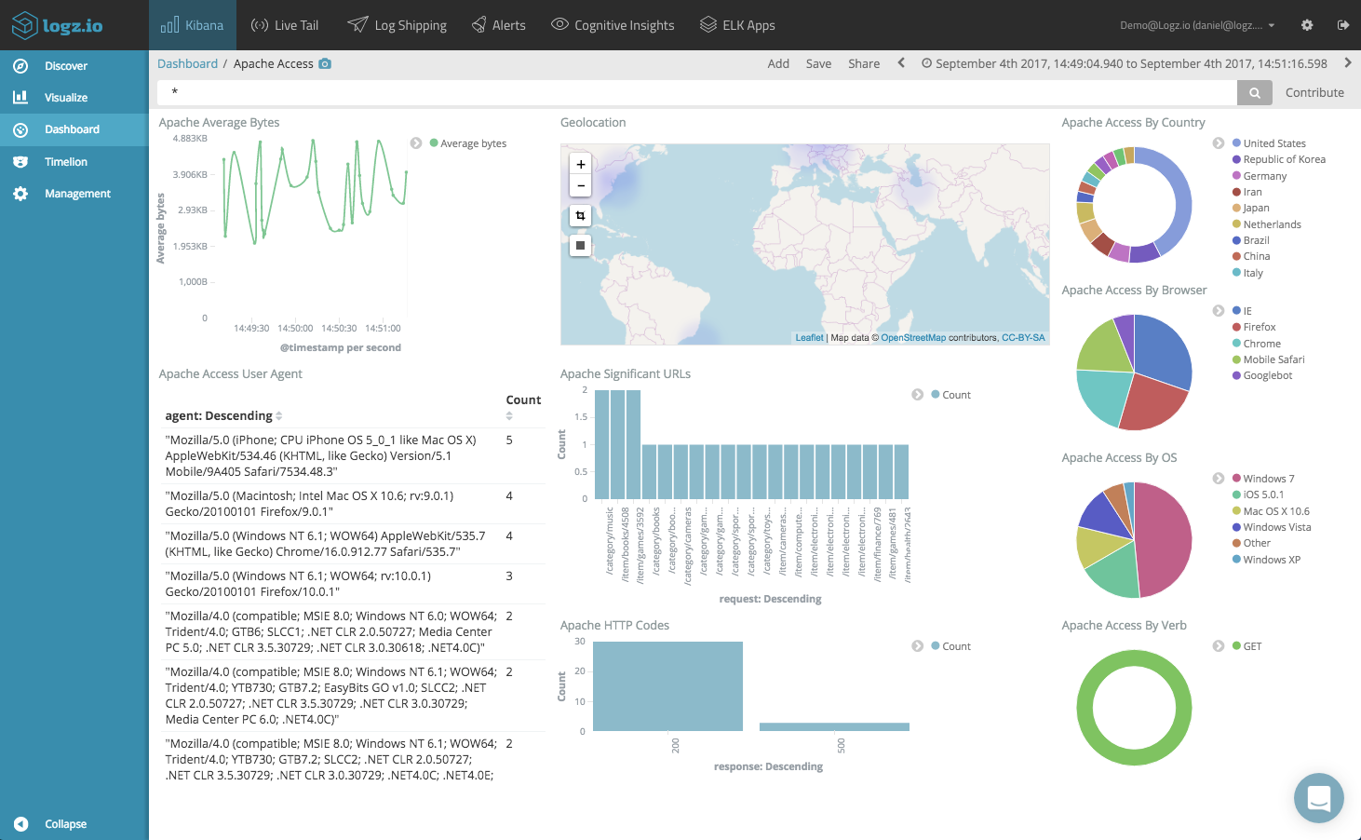
1.2.4 Visualisation in Log Monitoring
Apache log metrics being visualised on Kibana collected by elastic stack.
The metrics, which are being visualised are:
Source of request on geographical bases
Source of request from browser
Source of request from OS
Apache status codes
Request count
Access logs etc.
Source: https://logz.io/wp-content/uploads/2017/09/Dashboard-Art.png
Notes:
Notes to the Facilitator:
Explain the Visualization in Log Monitoring to the participants.
Notes to the Participants:
Log Monitoring is the process of reviewing collected logs of a system which are constantly shipped from a system to the monitoring database.
The metrics which are being visualised are:
Source of request on geographical bases
Source of request from browser
Source of request from OS
Apache status codes
Request count
Access logs etc.

Slide 9
What did You Grasp?
Which visualisation tools is best suitable for logs?
Grafana
Catchpoint
Kibana
New Relic
Notes:
Notes to the Facilitator:
Answer:
C. Kibana

Slide 10

1.3 Alerts
In case of any exception, alerting the teams is necessary.
Source: https://www.uptrends.com/Frontend/Images/sub/features/alerting-channels.png
Notes:
Notes to the Facilitator:
Explain to the participants what Alerts are.
Notes to the Participants:
After collecting data from source and keeping it in monitoring solution, the next step is to enable alerts with appropriate thresholds to notify teams when an unexpected data or state is observed. For example, In case of infrastructure monitoring, if CPU utilisation spikes more than normal operation teams should be notified to identify the root cause and fix those issues. Similarly, for other monitoring solutions as well, it could be an exception log in application which might need developer attention or slow page reload for end user. These kind of exceptions are to be notified with the help of alerting mechanism.

Slide 11
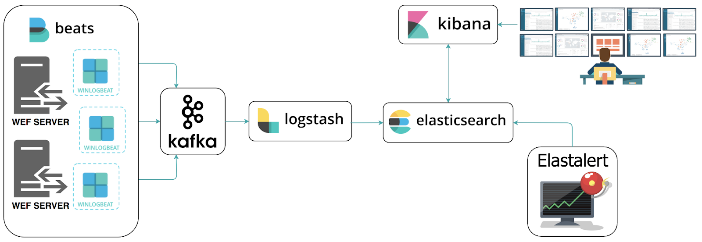
1.3.1 Alerting with Elastalert
Elastalert as alerting solution with Elastic Stack in log monitoring.
Source: https://miro.medium.com/max/3200/0*wLY_Pfptc9JeNXW9
Notes:
Notes to the Facilitator:
Explain the “Alerting with Prometheus”.
Notes to the Participants:
Elastalert manager is a go to tool for alerting if Elastic stack is being used both being developed by same community which is elastic.co. We define alerts in elastalert for a specific exception string. Beats ships logs to logstash for filtering which is then forwarded to elasticsearch DB, elastalert queries data from elasticsearch DB and when that string matches in any of desired log the alerts are triggered and can be notified to various channels like slack, telegram, email, pagerduty and so on.

Slide 12




1.3.2 Alerting with Prometheus
Alert Manager as alerting solution with Prometheus monitoring.
Prometheus Target
Pull metric
Install Prometheus
Install Grafana
Install AlertManager
Install Node Exporter
Alert
AlertManager
Send Notifications to End Users
through Slack and E-mail
Notes:
Notes to the Facilitator:
Explain the “Alerting with Prometheus”.
Notes to the Participants:
Alert manager is a go to tool for alerting if prometheus is being used both being developed by same community. We define alerting equation in promql (Prometheus query language) in alert manager for a specific threshold. It polls data from prometheus server and when the equation surpasses the threshold the alerts are triggered and can be notified to various channels like slack, telegram, email, pagerduty and so on.

Slide 13
What did You Grasp?
Which parameter is used log monitoring to trigger an alert?
System metric
Exception or error string
Threshold for response time
Threshold for throughput of application
Notes:
Notes to the Facilitator:
Answer:
B. Exception error string

Slide 14
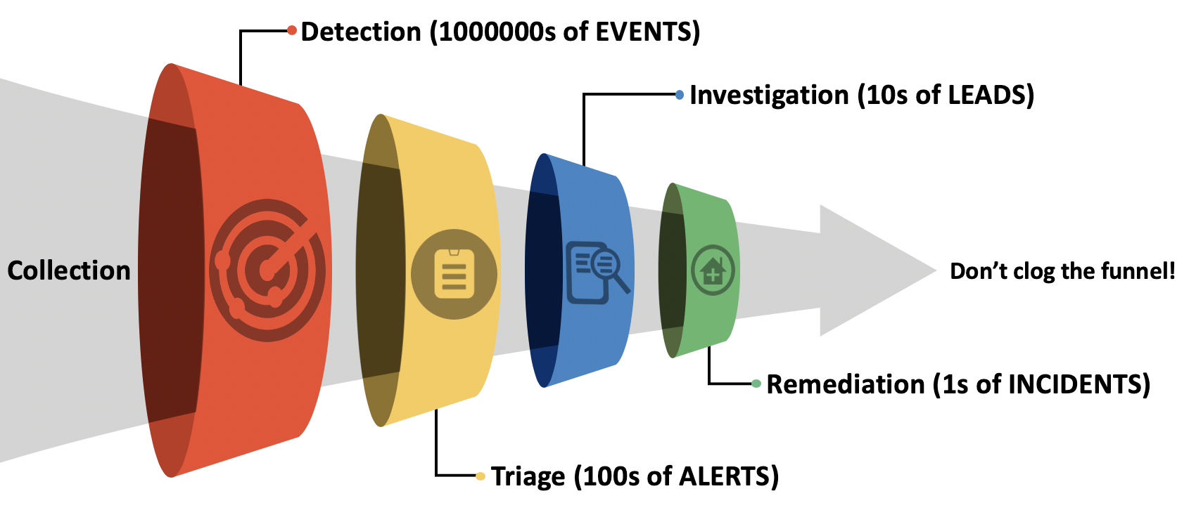
1.4 Alert Triage Process
Alert Triage is the process of reducing noisy alerts.
This process includes three steps:
Identify
Map
Eradicate
Source: https://miro.medium.com/max/3400/1*vS3SAuKsSAfFrTXjKSJDwg.png
Notes:
Notes to the Facilitator:
Explain the “Alert triage process”.
Notes to the Participants:
Alert Triage is a process of refining the alerts by eradicating the noisy alerts, going through all alerts and identifying the severity of the alert on the basis of that it is decided to be escalated or not.
This process includes three steps:
Identify
Map
Eradicate
Let’s discuss these in detail in next slide

Slide 15



1.4 Alert Triage Process (Contd…)
The alert triage can be done with three simple steps:
Identify
Map
Eradicate
Notes:
Notes to the Facilitator:
Explain the Alert triage process to the participants.
Notes to the Participants:
Following these three steps we can reduce noisy alerts and working on necessary alerts only.
Identify: We need to identify the alert in accordance with its priority, higher the precedence more will be the escalation. Suppose an alert is triggered regarding network security monitoring, it will definitely need more attention and deeper investigation.
Map: Once the identification is done on the priority basis then we need to map those alerts with the respective teams that too will be on the basis of levels and keeping NOC team in consideration. The first line of defence will be NOC team if any of alert they are not able to handle, which is out of their expertise then it should be escalated to more technical sound team. In this case, NOC will be L1 and other teams will be L2 and L3.
Eradicate: Once the mapping is done then the alerts, which have low precedence and low risk also which get auto resolve should be tuned. For example, a CPU alert gets triggered daily at 12 pm maybe because of some backup and restore activity then we need to fine tune that alert by increasing the observing time.
With these steps, we can eradicate most of the alerts and the rest alerts will be only those who actually require to be acted on.

Slide 16
What did You Grasp?
Who will receive the alerts at very first level?
Software Developer
Operations team
Managers
NOC team
Notes:
Notes to the Facilitator:
Answer:
D. NOC team

Slide 17
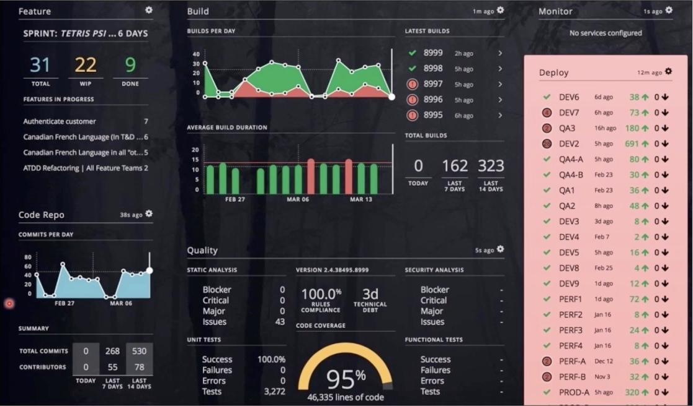
1.5 DevOps Dashboard with Hygieia
Hygieia is a monitoring tool, which polls data from devops tools, like Jenkins.
Source: https://i.ytimg.com/vi/t9eI1FdQ_cs/maxresdefault.jpg
Notes:
Notes to the Facilitator:
Discuss the DevOps dashboard with Hygieia with the participants.
Notes to the Participants:
Hygieia is a capital one dashboard, which can pull data for devops tools, unlike other traditional tools it also pulls data from CI/CD tools like jenkins and provide dashboards visualising sprints, pipeline status, code repo, latest builds etc.
The audience of hygieia is engineers as well as executives can have the information relevant to them, it has following insights:
DevOps Maturity: It provide dashboards of fully automated CICD with real time pipelines.
Risk Management and Investing: The insights provided by this tool helps in evaluating the developmental data, providing a direction where to invest in order to improve processes that reduce unnecessary risk taking in the future.
Ongoing Enhancements for Agile Environments: It quantifies DevOps metrics to track and improve DevOps maturity.
Establishes and Raises Standards: It sets and achieves a profile for maturity metrics and products. When products dip below the bar, it triggers an alert notification. In addition, this bar goes up incrementally to ensure that all products undergo simultaneous improvements

Slide 18
What did You Grasp?
In which monitoring The problems are eliminated before they occur?
Proactive monitoring
Agentless Monitoring
Agent based monitoring
Reactive Monitoring
Notes:
Notes to the Facilitator:
Answer:
A. Proactive monitoring

Slide 19
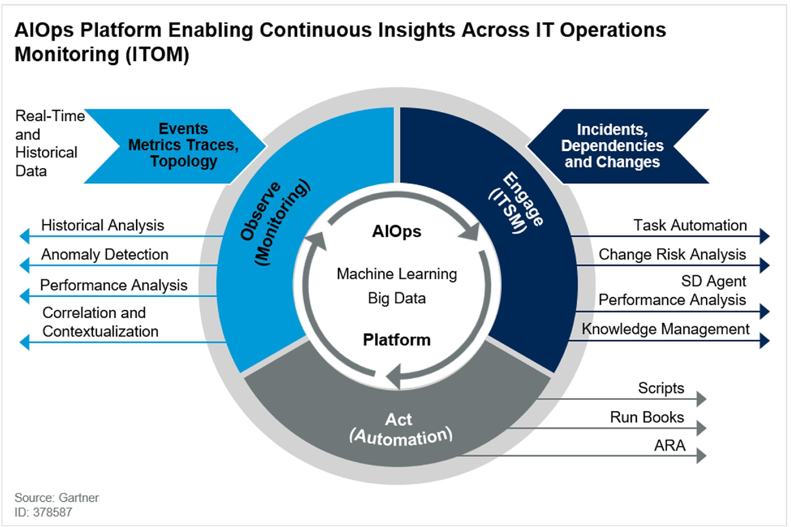
1.6 AI in Monitoring - AIOps
Matrix of AI and DevOps:
Notes:
Notes to the Facilitator:
Explain the AI in monitoring - AIOps to the participants.
Notes to the Participants:
AiOps is the amalgamation of IT operations approach with AI, It refers to multi-layered technology platforms that automate and enhance IT operations through analytics and machine learning (ML). We tend to collect a lot of historical data in our IT infrastructure from various domains with the help of big data automatic spotting and reacting to issues in real-time can be done, while still providing traditional historical analytics.

Slide 20
What did You Grasp?
Which monitoring suite offers a SAAS based solution?
Cloud Monitoring
On-Prem Monitoring
Hybrid Monitoring
Pay as per usage model
Notes:
Notes to the Facilitator:
Answer:
A. Cloud monitoring

Slide 21
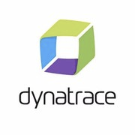







1.7.1 Tools Overview End User Monitoring
Some prominent end user monitoring tools available in market:
Notes:
Notes to the Facilitator:
Explain the “Tools overview”.
Notes to the Participants:
There are some prominent tools in market, which provide exceptional end user monitoring. These are:
Dynatrace
SolarWinds Pingdom
ThousandEyes
Catchpoint
AppNeta
MicroFocus
Nexthink
eG enterprise

Slide 22
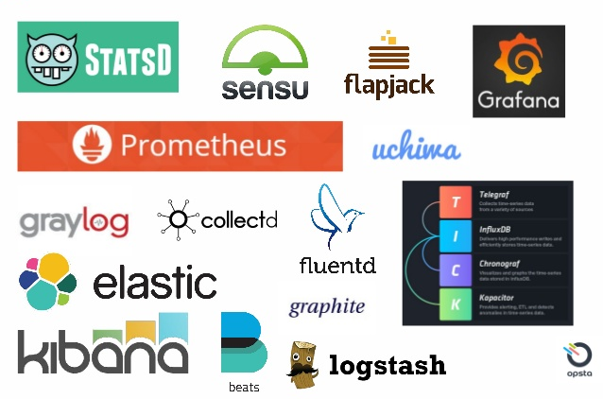
1.7.2 Tools Overview Infrastructure Monitoring
Some of the prominent infrastructure monitoring tools are:
Notes:
Notes to the Facilitator:
Explain the infrastructure monitoring tools to the participants.
Notes to the Participants:
Some of the prominent infrastructure monitoring tools are:
StatsD
Sensu
FlapJack
Grafana
Prometheus Stack: Exporters, Prometheus, and Grafana
InfluxDB Stack: Telegraph, InfluxDB, Chronograph, and Kapacitor
Uchima
Graylog
CollectD
Elastic Stack: Beats, logstash, Elasticsearch, and Kibana

Slide 23
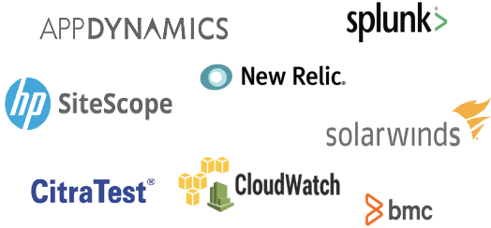
1.7.3 Tools Overview Application Monitoring
Some of the prominent application monitoring tools are:
Notes:
Notes to the Facilitator:
Explain the application monitoring tools to the participants.
Notes to the Participants:
Some of the prominent application monitoring tools are:
AppDynamics
Splunk
SiteScope
New Relic
Citra Test
Cloudwatch
BMC
Solar Winds

Slide 24

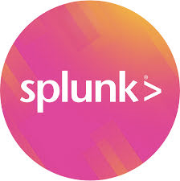

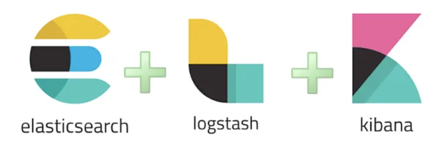

1.7.4 Log Monitoring Tools
Some of the prominent log monitoring tools are:
Notes:
Notes to the Facilitator:
Explain the log monitoring tools to the participants.
Notes to the Participants:
Some of the prominent log monitoring tools are:
Graylog
Loggly
Logstash: ELK stack
Splunk
Fluentd

Slide 25
What did You Grasp?
Which tool can provide Infrastructure as well as log monitoring?
Loggly
Prometheus
ELK
Catchpoint
Notes:
Notes to the Facilitator:
Answer:
C. ELK

Slide 26
In a Nutshell
In this module, you learnt:
Visualisation of monitoring data
Setting up alerts
Process of alert triage
Dashboarding with hygieia
Scope of AI in Monitoring - AIOPS
Brief overview of tools available
Notes:
Notes to the Facilitator:
Share the module summary with the audience.
Ask the participants if they have any questions. They can ask their queries by raising their hands.
Notes to the Participants:
Now, you have reached the end of the module, In this module, you learnt:
Visualisation of monitoring data
Setting up alerts
Process of alert triage
Dashboarding with hygieia
Scope of AI in Monitoring - AIOPS
Brief overview of tools available

